Slide 1
Electrical Risks, Safety and Solutions for Older Homes
Presented by:
Brian Cook
PowerCheck Electrical
Safety Services
www.powercheck.ca

Slide 2
Learning objectives
To understand the different types of wiring used in older houses
To recognize the leading electrical fire concerns in older houses
To understand the PowerCheck program

Slide 3
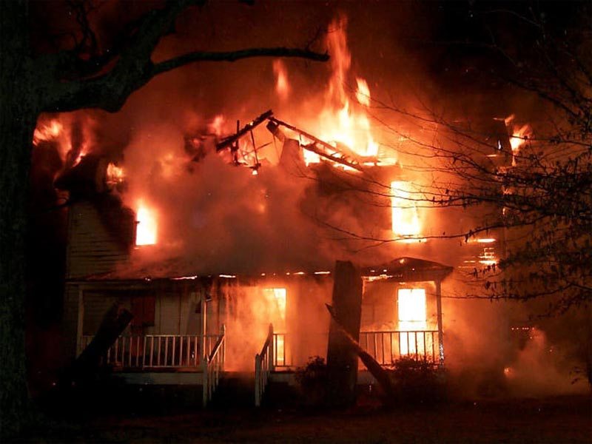
Electrical fires
In BC, 2004-2007
  633 reported electrical fires
  4 fatalities
  $55.7 MM property loss
  Represents ~10% of reported fires

Slide 4
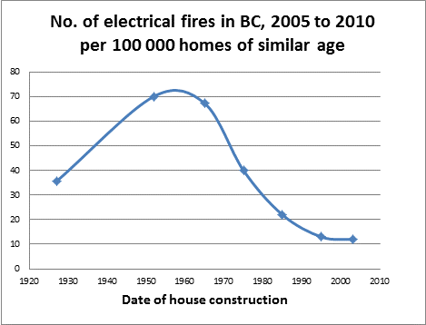
As houses ages:
Probability of fire increases
In 25% date of house construction unknown. Data source: BC OFC

Slide 5
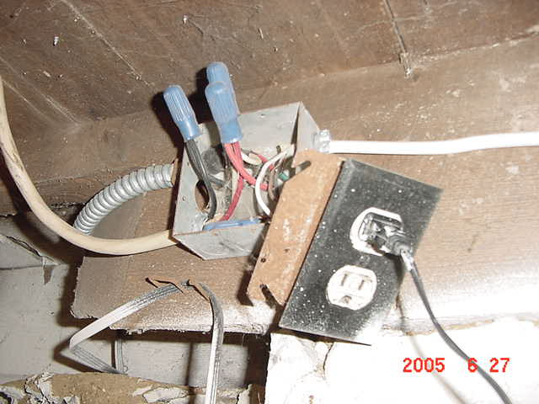
What is causing electrical fires?
Old services, panels & wiring
  Important to check, and sometimes faulty, though not the leading cause of electrical fire
Handyman tinkering
  Accounts for the vast majority of electrical fires.
  Hazardous add-ons build up over the years.
  Sometimes old houses are rampant with hazardous handyman add-ons
ALL TOO COMMON.
In older homes hazards such as this add-on basement receptacle are commonly found. These hazardous additions put the house at high risk of electrical fire.

Slide 6
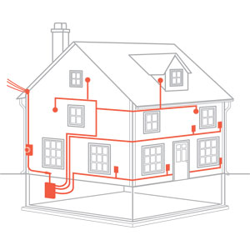
Electrical System Components
Three components to your electrical system:
  Service & Panelboard
  Wiring
  Electrical devices
    (switches, receptacles, lights)
Wiring
Electrical devices
Service & Panelboard

Slide 7
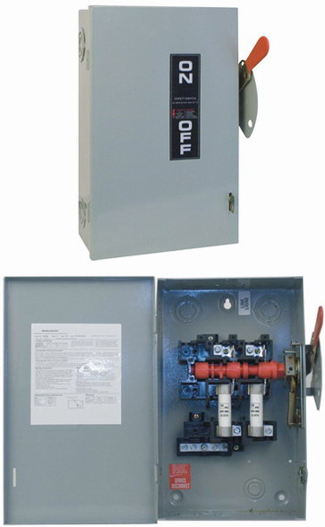
Service: 60-amp
Until the1970s nearly all homes had 60-amp service.
Original 60-amp services can be acceptable today, if there has been no additional circuits or tampering.
Homeowners today are often not aware their home has 60-amp service.
“Rated for 100 amps”
60-amp fuses,
60-amp service
Old service boxes often have the wording “Rated for 100 amps”. This refers to the box rating, not service size.
Notes:
7

Slide 8
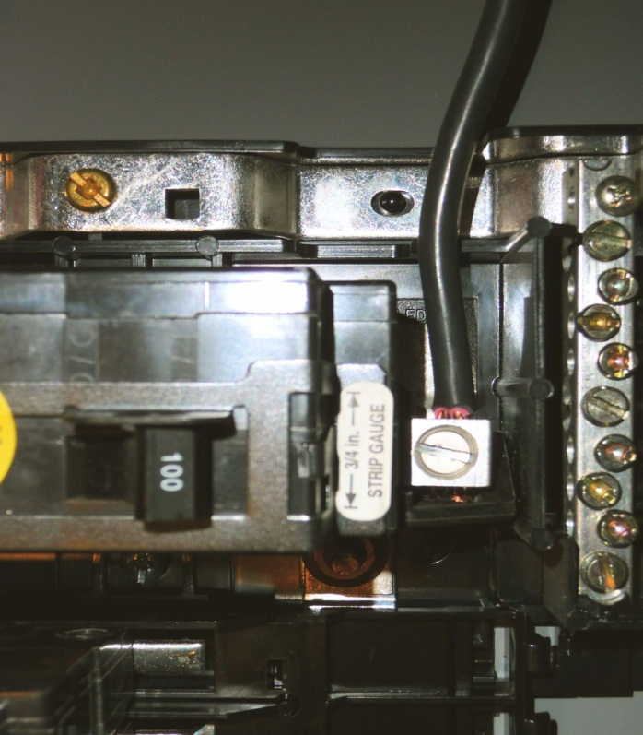
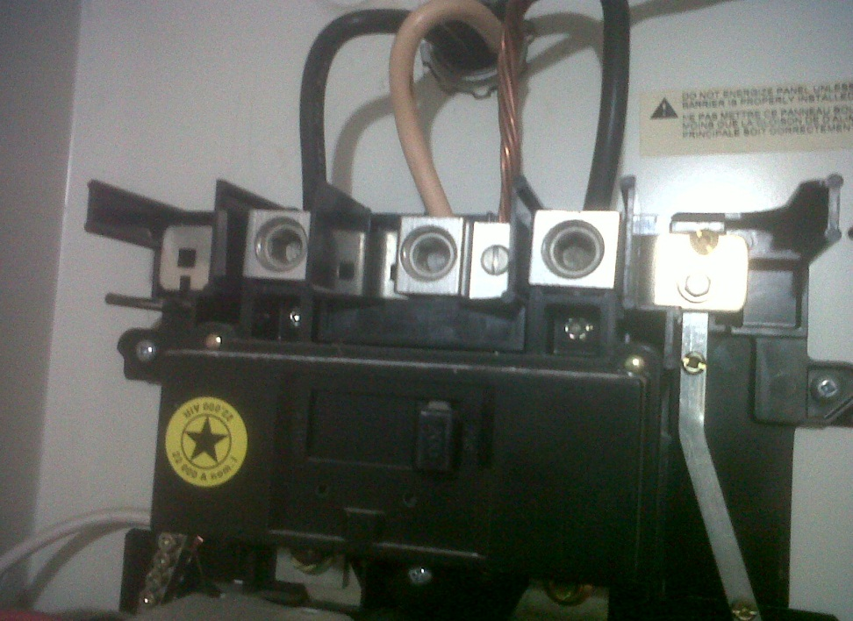
Sometimes panelboards have been hazardously upgraded
60 amp
200 amp
200 amp main breaker on 60 amp service!
100 amp main breaker on 60 amp service!

Slide 9
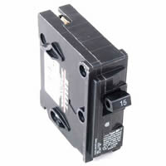
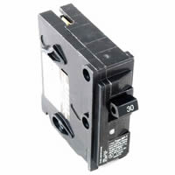
Common hazard in panelboard:
An over-rated circuit breaker…
15-amp circuit breaker
30-amp circuit breaker
Notes:
9

Slide 10
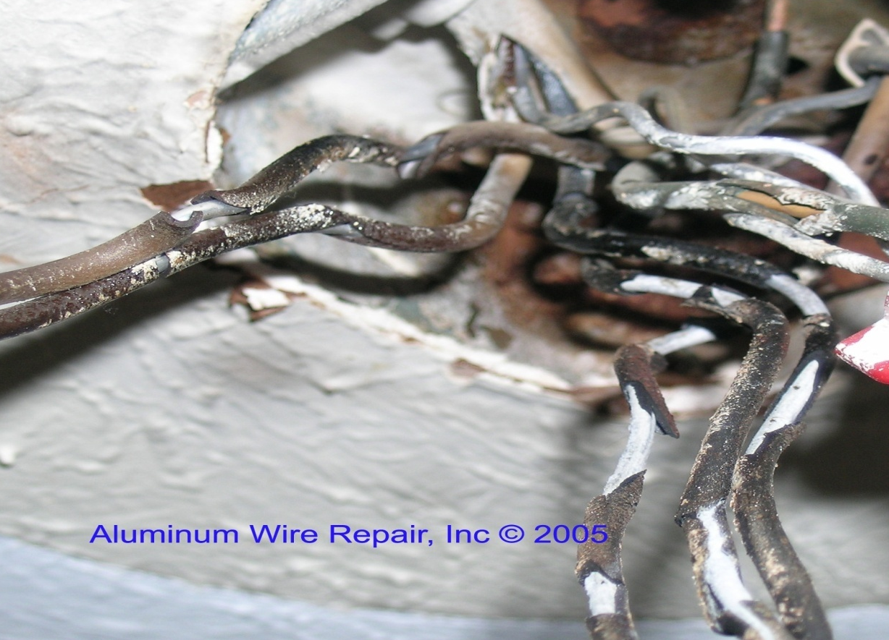
…can create over-heated conductors
Notes:
10

Slide 11
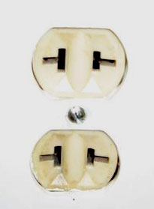
Wiring before 1950: Knob and tube
Installed in nearly all homes built before 1950.
Still present in most
pre-1950 homes today.
Often concealed thus hard to identify, particularly if outlets have been changed.
Original two-prong, ungrounded receptacle

Slide 12
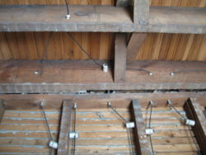
Knob and tube: Qualities
Characteristics:
  Two single conductors
  Supported by porcelain
  knobs and tubes
A well designed system:
  Heavy gauge conductors
  Spaced well apart
  All connections soldered
Work seldom done by non-professionals
knobs
tubes
If basement has been finished, and new panel installed, knob and tube is likely concealed, behind the walls and in the ceilings

Slide 13
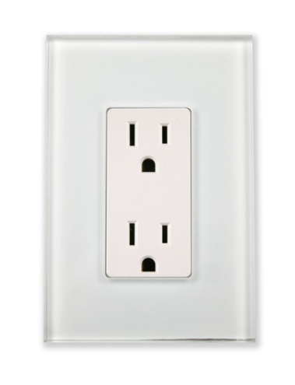
Knob and tube: Hazards
Original 2-prong outlets: Now 3-prong:
Result: No ground protection
Original lighting: Now recessed lighting
Result: Insulation breakdown
The limited number of outlets in older homes spurred add-on circuits, so often installed by unqualified people.
Result: Hazardous add-on circuits
In 99% of older homes, the original 2-prong outlets have been found swapped for modern 3-prong, falsely presenting receptacles are grounded.

Slide 14
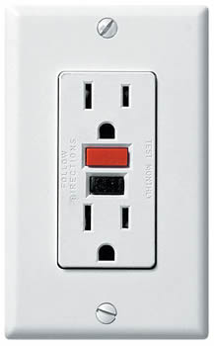
Knob and tube: Solutions
Rewire: $20,000 +
or
If wiring checks out fine:
GFCIs can provide excellent ground protection: $20 each
Note: Vast majority of homes:
Old wiring = Excellent condition!
AN EXCELLENT SOLUTION!
GFCI receptacle provides excellent ground protection.
It disconnects the power if leakage to ground exceeds 5 mA.

Slide 15
Knob and tube: Findings
In 99% of homes:
Knob and tube wiring is still live today
  Usually not visible due to new panel and finished basement.
Knob-and-tube wiring is in excellent condition
  No need for expensive replacement, but:
Original 2-prong outlets now modern 3-prong
  Falsely presenting outlets are grounded, thus rated “High Risk”.
  Cost to eliminate fire risk: Less than $500
RESULT: SAFE AND HAPPY HOMEOWNERS!

Slide 16
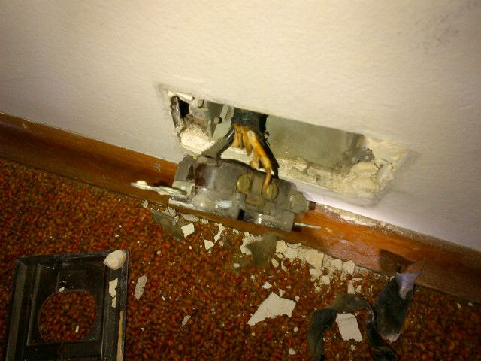
1950s: Ungrounded cable “NMD1”
New cable introduced 1950.
Installed in most homes throughout the ‘50s
Similar to knob and tube, presenting same fire concerns:
  Original 2-prong outlets now 3-prong
  Not suitable for recessed lighting
  Due to limited number of outlets installed at time of construction:
  Probability of hazardous add-ons in home is high.
Due to speed of installation NMD1 quickly replaced knob-and-tube wiring. Shown here, feeding a 3-prong receptacle

Slide 17

Wiring of the 1960s
NEW cable introduced in the 1960s:
“With ground”
Fire hazards:
  Though providing ground protection, the insulation is still not suitable for recessed lighting.
  Due to limited number of outlets installed at time of construction, probability of hazardous add-ons being present in home is high.
Introduced in the late 1950s: “NMD3”. Same conductors as NMD1, but “With ground”. Early versions had these words written on the cable jacket.

Slide 18
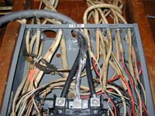
Wiring of the 1970s
A new cable with higher insulation temperature becomes the standard.
Suitable for recessed lighting.
Fire hazards:
  Due to the rapid rise in basement suites, kitchen renos and powering of garages: Unauthorized electrical work thrives.
  This is encouraged with the proliferation of self-help guide books and easy access of electrical supplies.
Modern wiring, NMD7 & NMD90 become the standard, but along with it comes “do-it-yourselfers”.

Slide 19
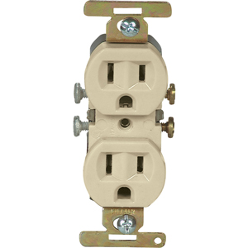
Aluminum wiring: 1966 – 1974
In vast majority of homes built 1966 – 1974.
Still present today
in most homes built
1966 – 1974.
Designed as a cost-effective solution due to the high price of copper during these years.
An aluminum-rated receptacle was required with the installation of aluminum wire.

Slide 20
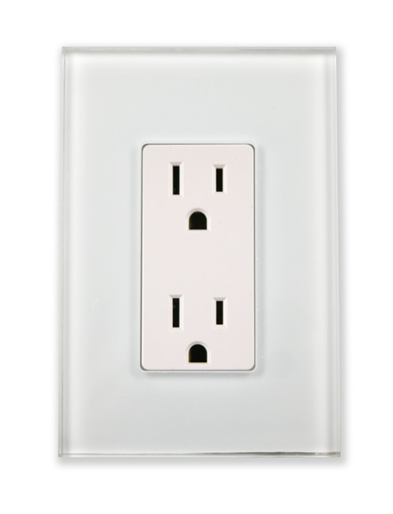
Aluminum wiring: Hazards
Aluminum wiring can be fine, but:
Original aluminum-rated outlets
are commonly found swapped for modern, non-aluminum-rated outlets
HAZARD: LOOSE & POSSIBLY CORRODED CONNECTIONS
FIRE HAZARD!
Original aluminum-rated outlets are commonly found swapped for modern, non-aluminum-rated outlets.

Slide 21
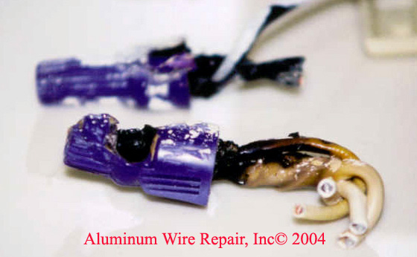
Aluminum wiring: Solutions
Rewire: $20,000
or
Approved copper pigtailing/ aluminum rated devices
Typical cost: ~$1000
Plus: Regular maintenance
Checking that electrical connections have remained sound, recommended every 15 years.
“If home [with aluminum wiring] has not been checked since new, it is high time overdue” (NFPA).

Slide 22
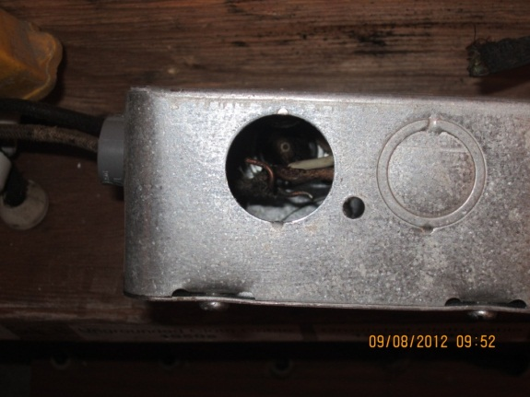
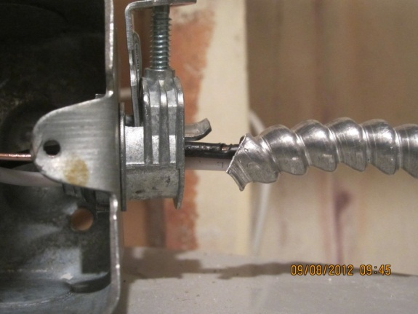
Hazardous add-ons
So prevalent in older houses, putting house at risk of fire
Multitude of ways, including:
  Incorrect cables
  Circuits poorly grounded
  Oversized circuit breakers
  Poor electrical connections
  Knock outs (“mouse holes”) in JBs and panels
  BX cables without antishorts

Slide 23
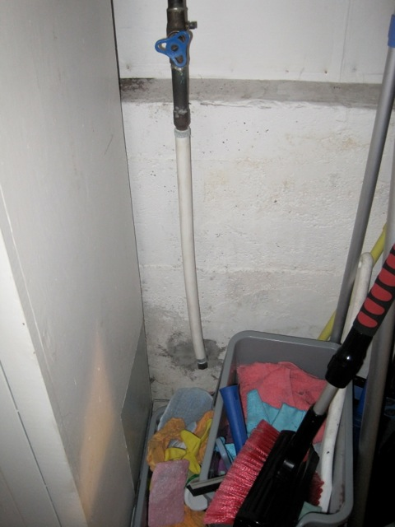
Some hazards are inadvertent actions from other trades
Original copper water pipe replaced with “PEX” plumbing pipe, disconnecting the service ground
Old hot-water-tank electrical cable left live and dangling.
Both these concerns commonly found

Slide 24
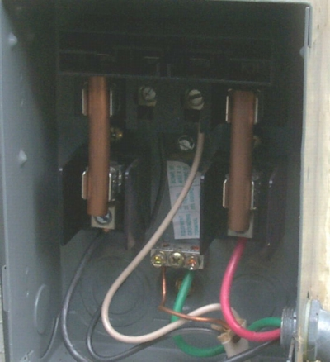
Houses with illegal suites show particularly increased risk
To accommodate additional power demands of multiple suites, original 60-amp fuses are sometimes found replaced with copper pipe, eliminating circuit protection, putting house in extreme peril.
This exact scene was found by PowerCheck in an older home in Vancouver. Homeowner believed he had 100-amp service due to rating on box.
Home was sent to us because of knob-and-tube wiring.

Slide 25
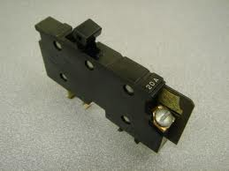
Old circuit breakers may not trip
Old breakers, such as Pushmatic, XO Sq. D & Federal Pacific do not have the fast trip characteristics of modern breakers
Old circuit breakers,
pre-1970s have well exceeded their rated service life.
Type XO breakers, by Square D should be replaced whenever identified.

Slide 26
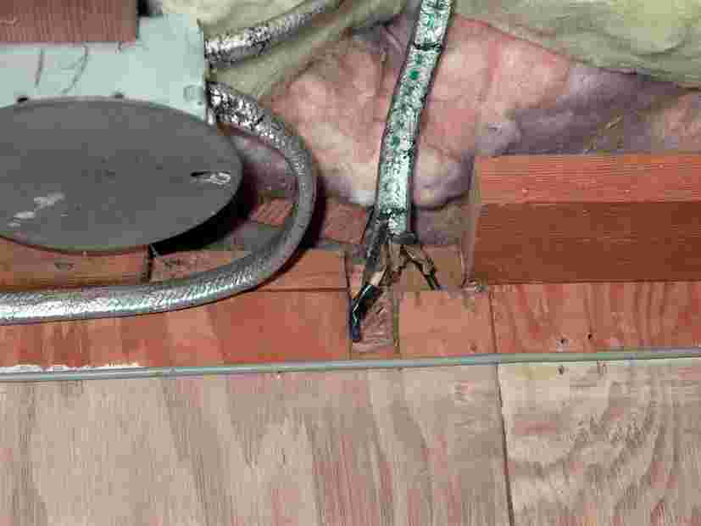
Exposed electrical connections
If connections become at all loose they will arc, easily igniting surrounding wall material.
Commonly found.
Exposed connections
This scene was found in a older home in New Westminster by PowerCheck. Home was sent to us because of knob-and-tube wiring.

Slide 27
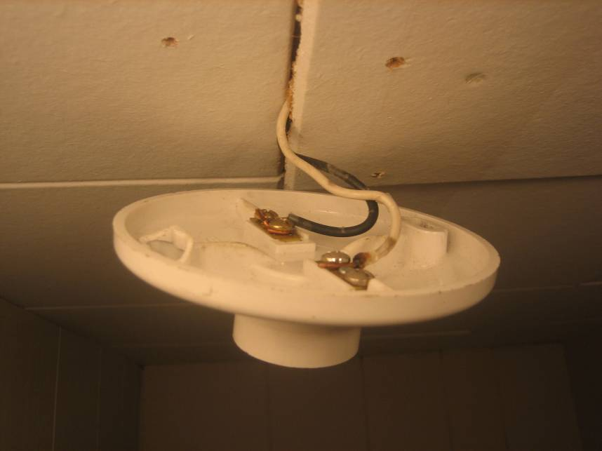
No junction box behind electrical device
If connections become at all loose they will arc, easily igniting surrounding ceiling material.
Commonly found.
Home was sent to us because of knob-and-tube wiring.

Slide 28
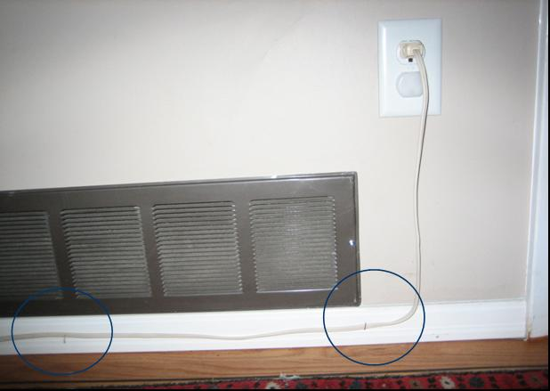
Extension cords stapled to walls
Staples put pressure on cord. Over time the cord insulation breaks down. The staple then creates a direct short across the wires, which can easily result in fire.
Commonly found.
staples
Home was sent to us because of knob-and-tube wiring.

Slide 29
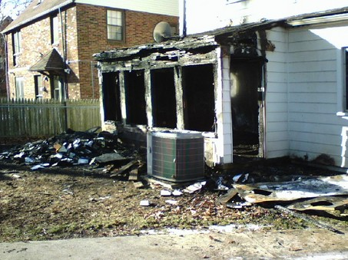
Baseboard heaters prone to fires
Electrical equipment needs to be installed with thorough knowledge of the electrical code.
Incorrect installation can easily result in electrical fires.
“Seven firefighters said the fire began about 1 a.m. near an electric baseboard heater. Three children died, ages 6, 2 and 14 months” (Cleveland News, Dec 5, 2007).
Notes:
http://blog.cleveland.com/metro/2007/12/third_child_killed_by_shaker_h.html

Slide 30
Statistics
Pre-1950 homes in general
Handyman tinkering
Old age
Electrical wire
Data source: First 100 homes examined by PowerCheck

Slide 31
Statistics
Pre-1950 homes with secondary suite
Handyman tinkering
Electrical wire
Data source: First 100 homes examined by PowerCheck

Slide 32
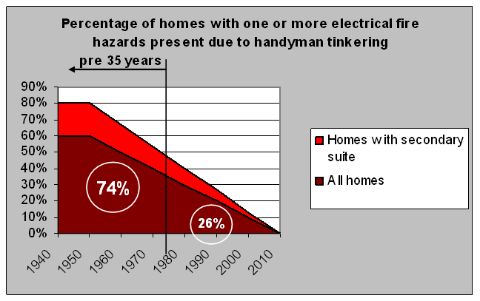
Risk and age
Notes:
Statistically old homes are more dangerous
This is primarily due to the compounding effect of handyman tinkering, building-up over the years
This is particularly noticeable in homes with secondary suites
If we were to examine all houses pre-25 years we would identify the vast majority of dangerous homes
Notes on data
Values based on preliminary data from 150 homes examined to date
With larger sample, values may vary from above, however clearly there is a trend

Slide 33
Summary
Electrical fire hazards are to be found in nearly all homes built before 1975.
Though deterioration of older electrical systems is occasionally found, the vast majority of fire hazards have been due to handyman tinkering.
Expected cost to bring home to “Medium Risk”, in vast majority of homes: < $1000
Expected cost to bring home from “Medium Risk” to “Low Risk”: $1000 - $1500

Slide 34
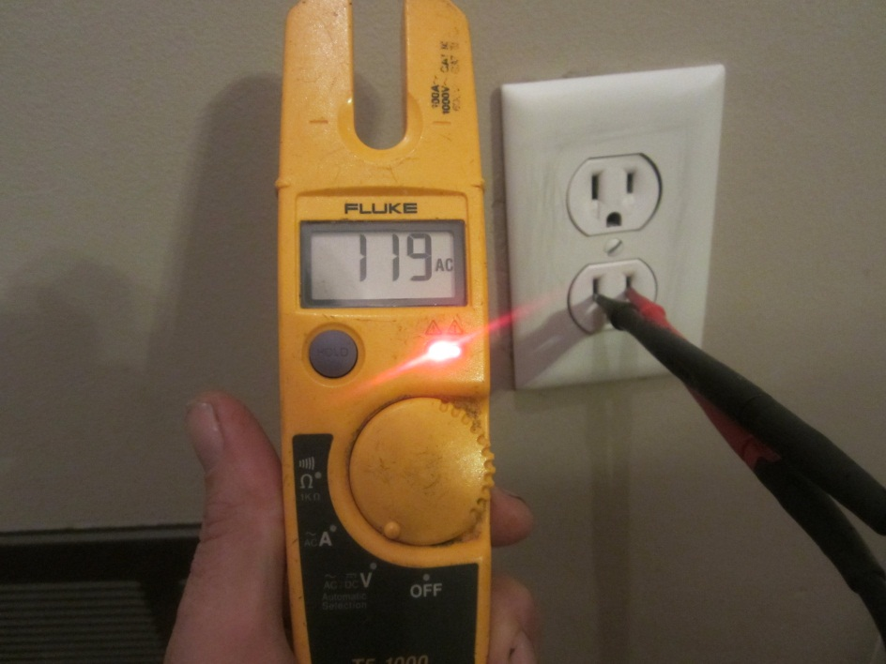
PowerCheck
Electrical Safety Assessment
Standardized
electrical safety examinations
Key points:
  Conducted only by master electrician
  Comprehensive 80-point examination
  Third party examination only

Slide 35
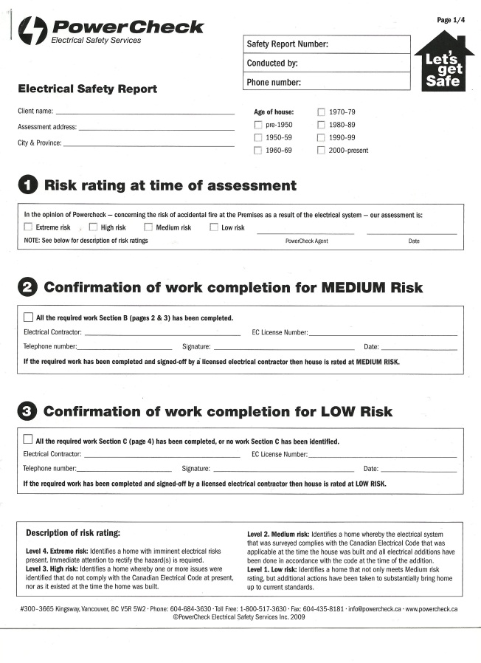
PowerCheck
Electrical Safety Report
Standardized risk rating
  Extreme
  High
  Medium
  Low
One price: $349 for all single family homes*
* 2012, up to 300m², within major city limits

Slide 36
PowerCheck
Risk Rating explained
Extreme Risk
  Serious fire hazards identified requiring immediate attention
High Risk
  Fire hazards identified. Repairs recommended ASAP
Medium Risk
  Acceptable condition.
  Complies with code at time of installation.
Low Risk
  Not only meets Medium Risk, but additional upgrades have been done to substantially bring home up to current standards.

Slide 37

The PowerCheck promise
Standardized examinations
Accurate and consistent reports
Examiners across Canada
Simplifying the electrical risk evaluation process
Over 2000 clients have had their electrical system examined by PowerCheck. Nearly all have said, “It was the best thing that we have ever done”.

