Slide 1
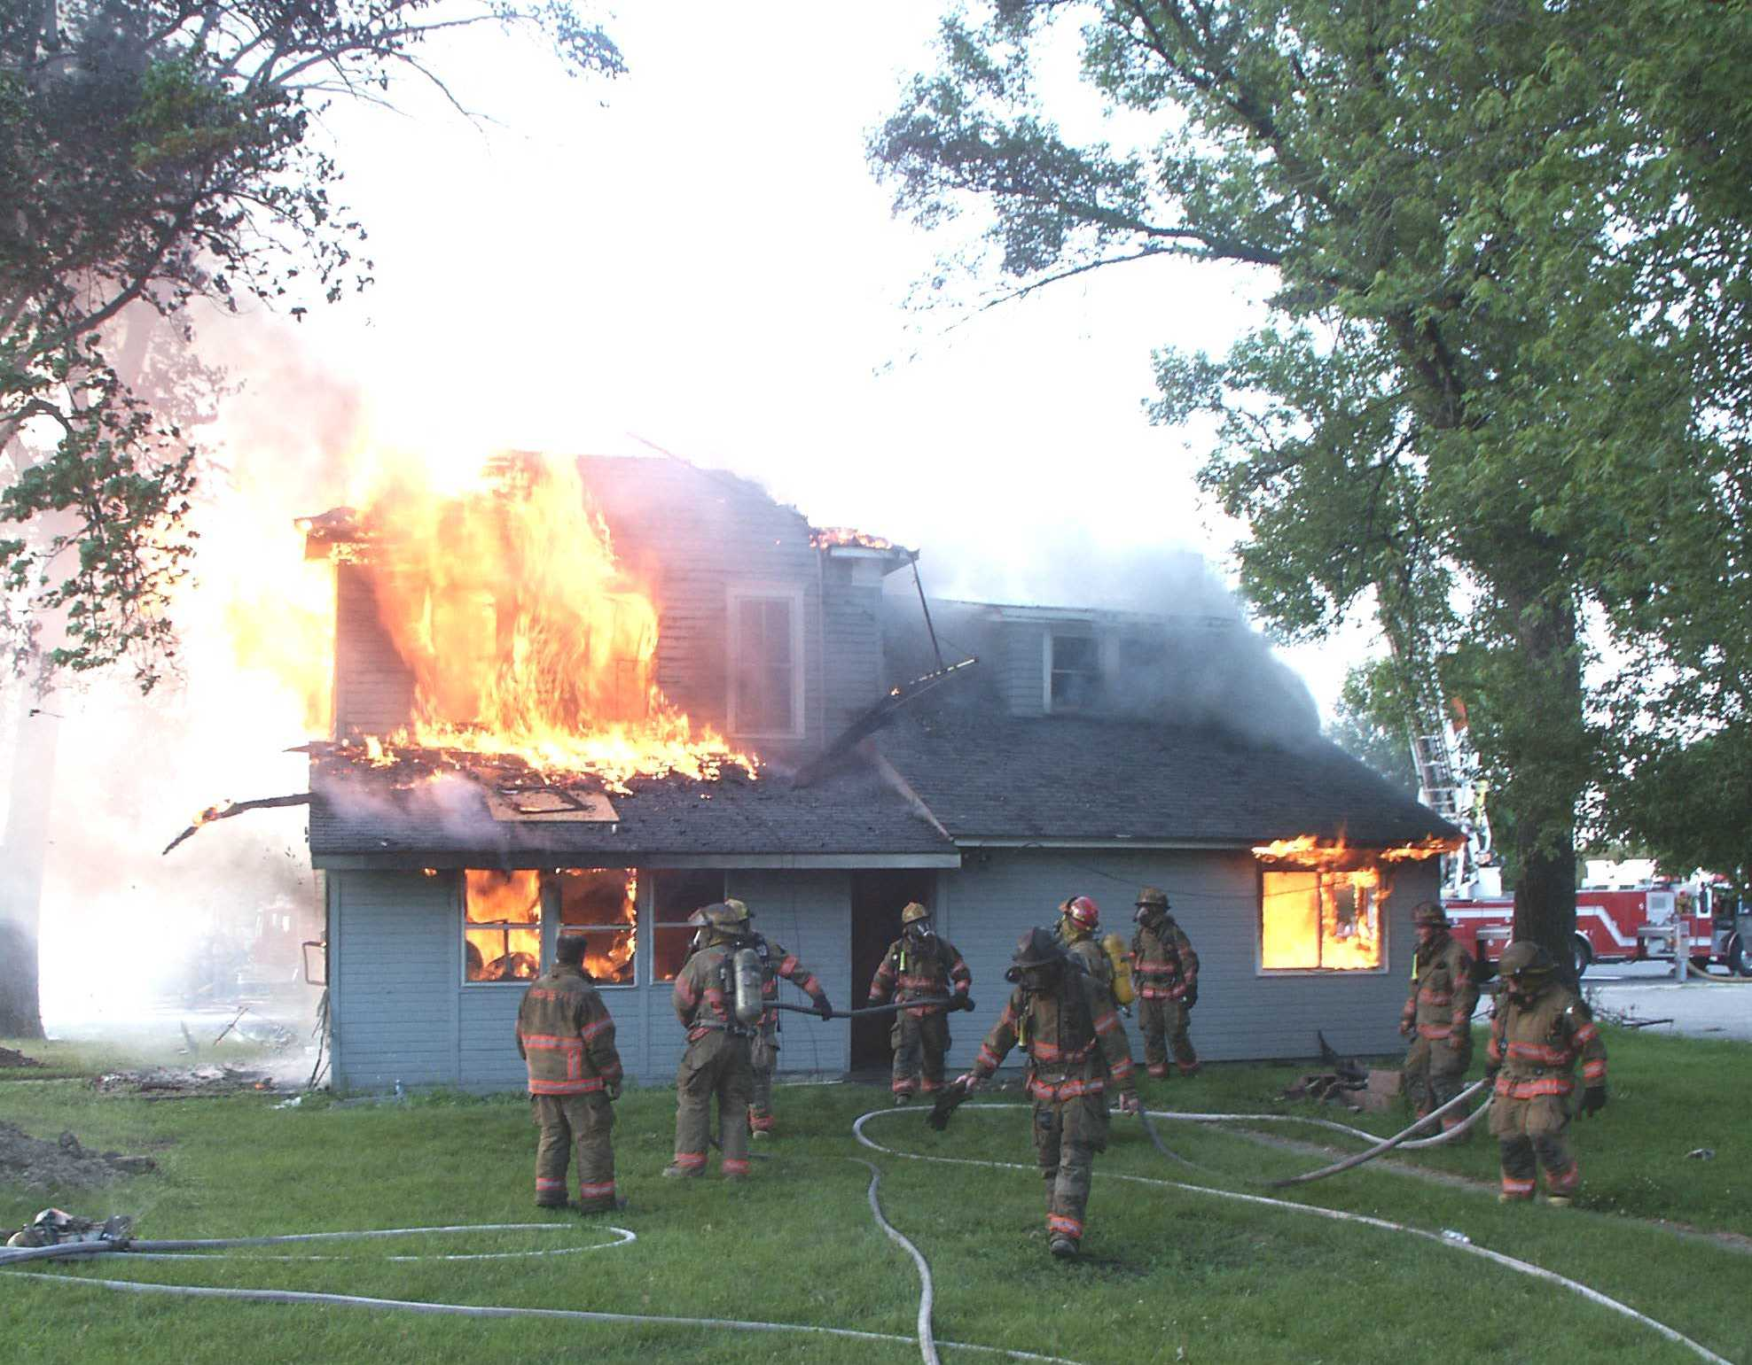
Electrical fires can be prevented!
By PowerCheck

Slide 2
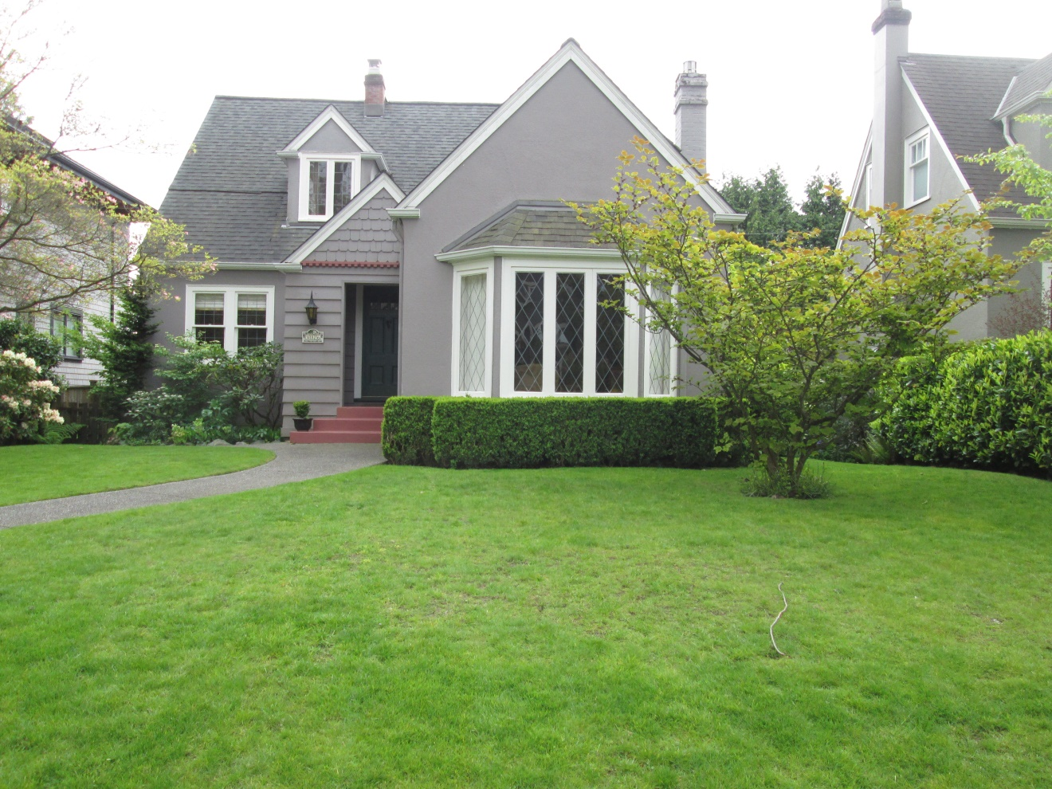
In This well kept older home…

Slide 3
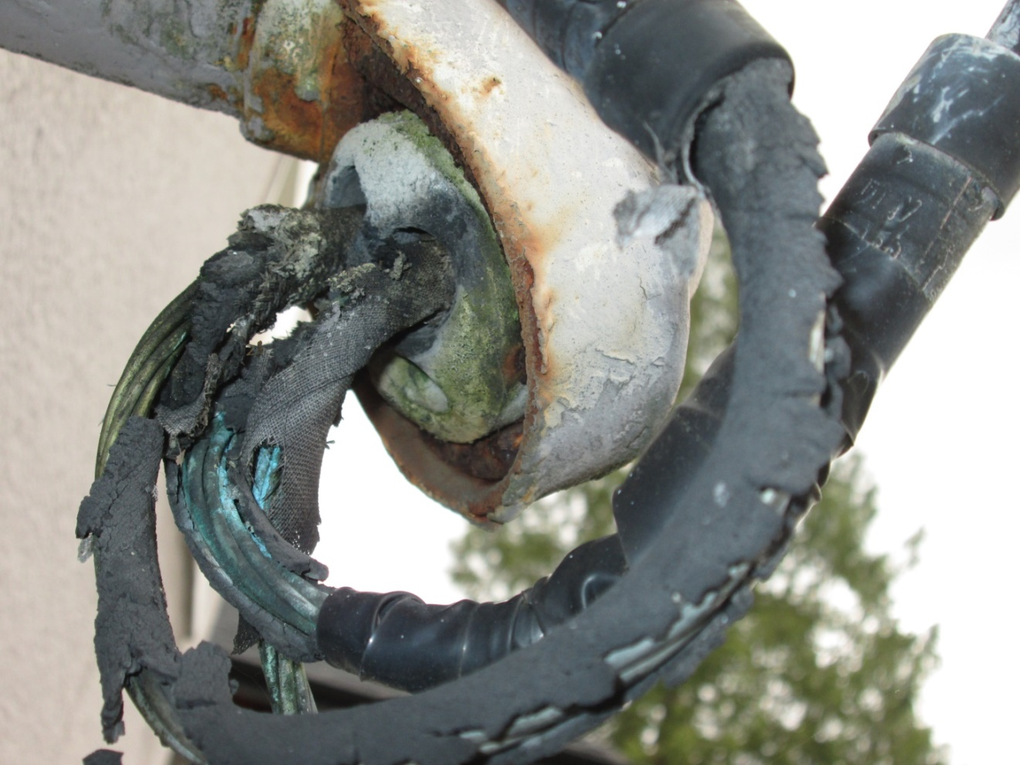
A SERIOUS Fire hazard wAS present
Deteriorated live conductors at service entrance of house, millimeters away from flashing and creating fire

Slide 4
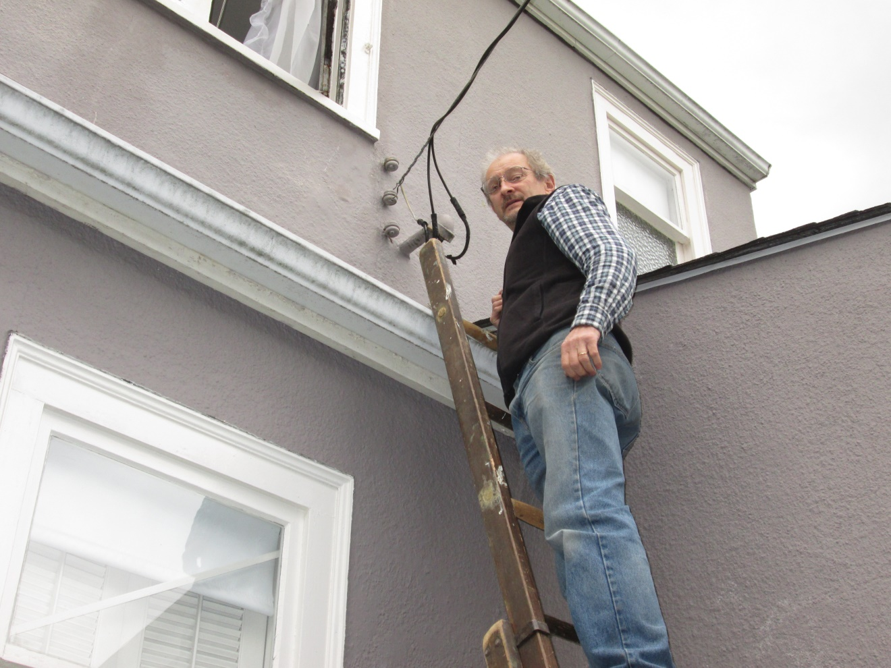
immediate attention was requested
Within one hour homeowner had their electrician on site to prepare new installation of electrical service

Slide 5
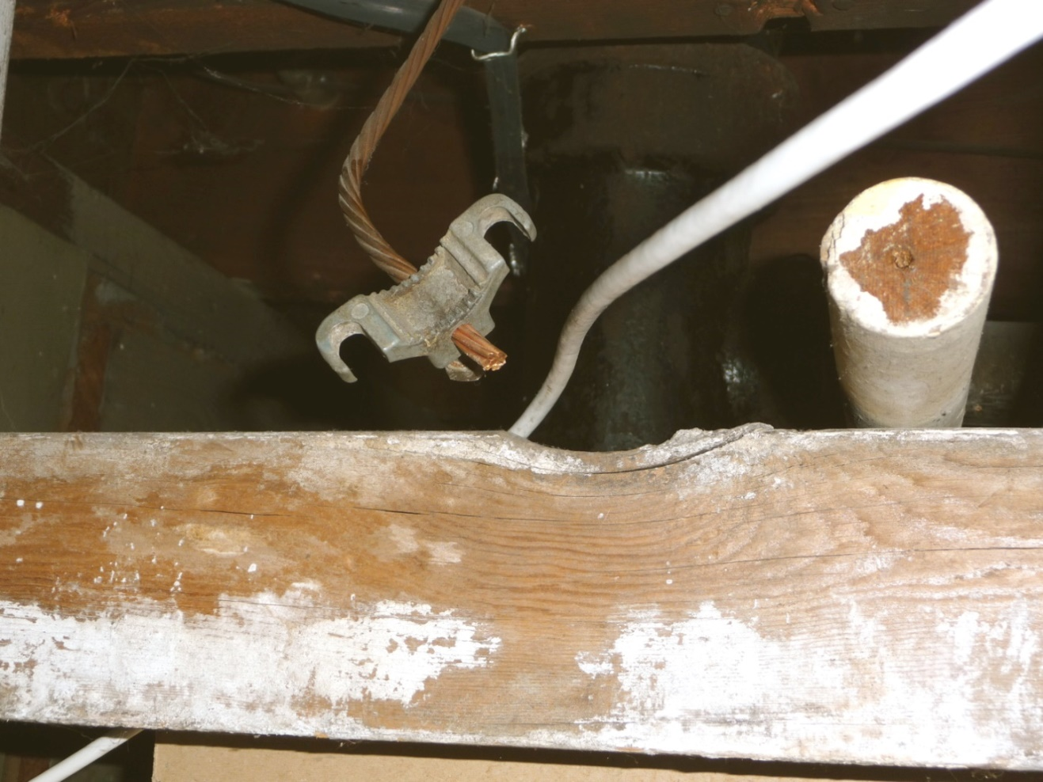
Key Fire Hazards in OLDER HOUSES, DUE to
Deterioration
Ground clamp has broken away from copper water pipe, increasing risk of fire and electrocution

Slide 6
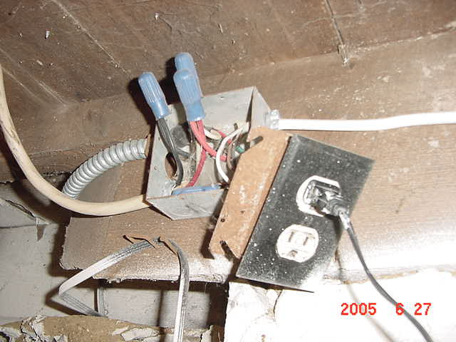
Handyman Add-ons
Multiple circuits hazardously installed, putting house at increased risk of electrical fire

Slide 7
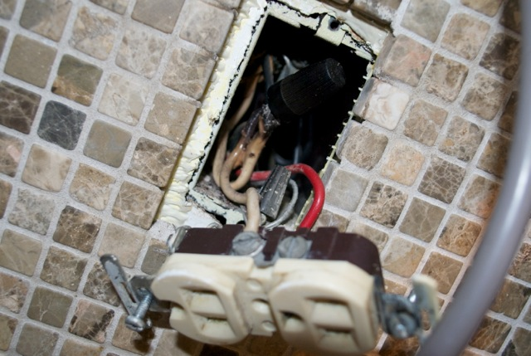
Handyman alterations
Burnt out
pigtails on
aluminum wire
due to incorrect wire connectors

Slide 8
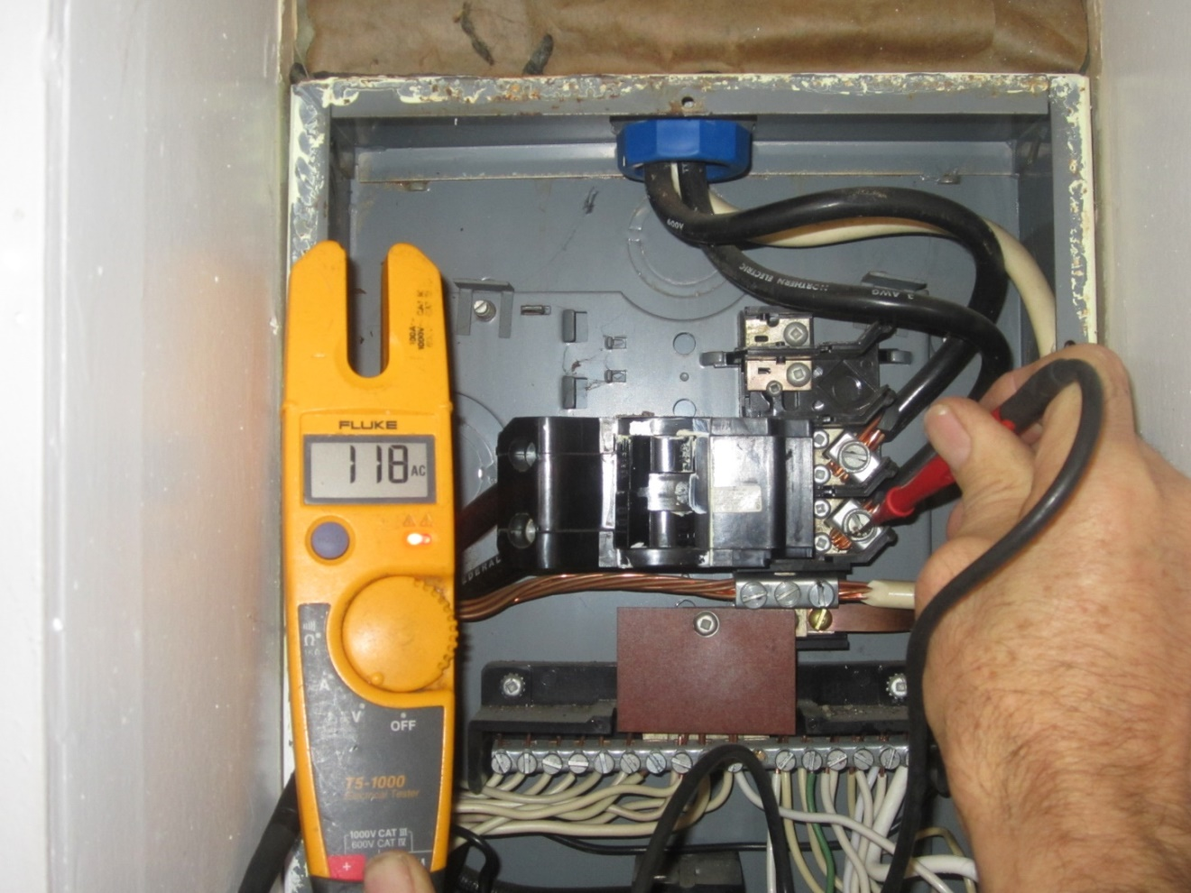
Old houses should to be checked thoroughly for Electrical safety

Slide 9
If it hasn’t been checked since new, it’s high time overdue !

Slide 10
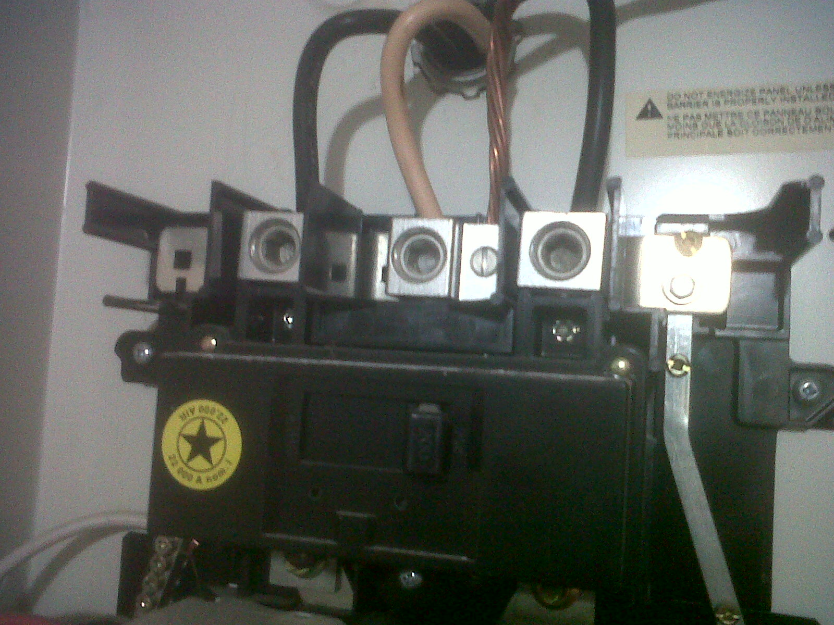
Problems WITH ELECTRICAL PANELS:
Oversized circuit breakers
60 amp service
This house is at increased risk of electrical fire
200 amp
circuit breaker

Slide 11
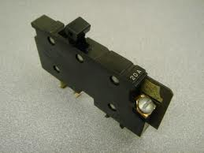
Obsolete circuit breakers
These circuit breakers, “Square D, Type XO” are no longer installed, as they do not meet modern specifications, putting house at increased risk of fire

Slide 12
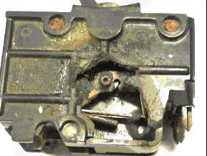
Burnt-out circuit breakers

Slide 13
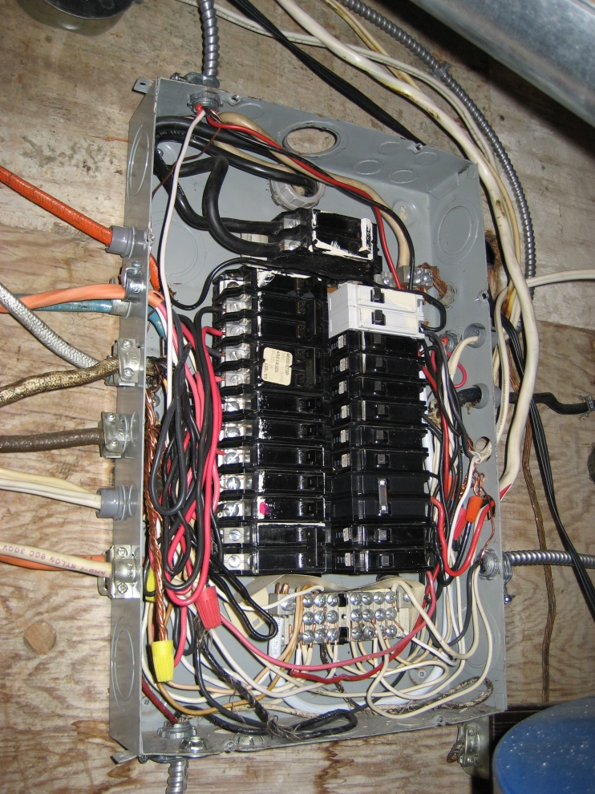
Loose electrical connections
As houses age, electrical connections often become loose, increasing risk of electrical fire

Slide 14
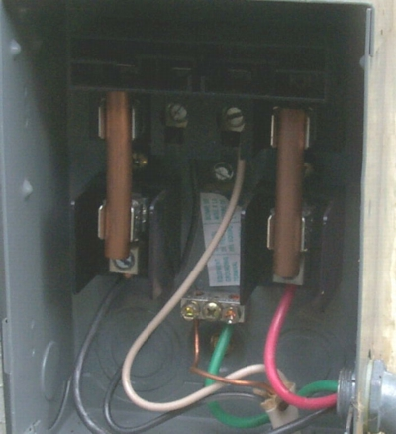
And on occasion:
A Complete disregard for safety
Original main fuses, in service switch replaced with short lengths of copper water pipe

Slide 15
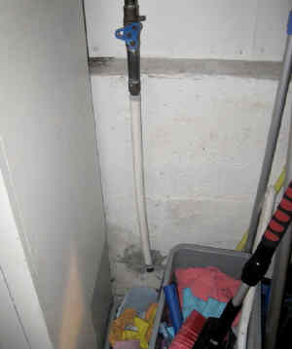
Some repairs compromise the electrical system
Repair of copper pipe with plastic PEX breaks the electrical grounding of the house

Slide 16
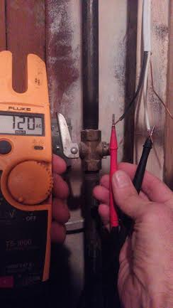
In old Homes
Electrical wires are often found live!
Live electrical conductor found millimeters from gas pipe
Often found in the basement, and sometimes in the vicinity of the gas pipe, live wire creates risk of fire and electrocution.

Slide 17
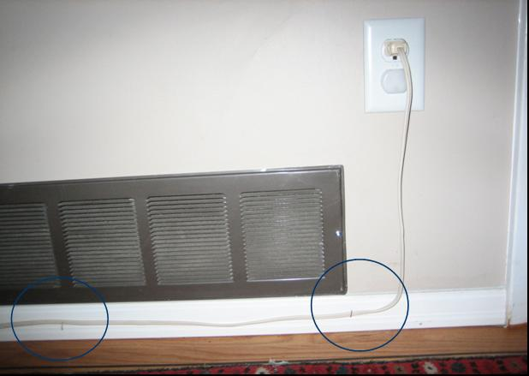
SOME Tidy-ups done by homeowners create serious fire hazards
Metal staples securing cord, over time can easily cut into the cord, creating fire

Slide 18
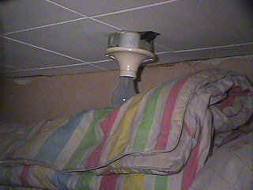
SOME ACTIONS BY occupants set scenario for fire

Slide 19
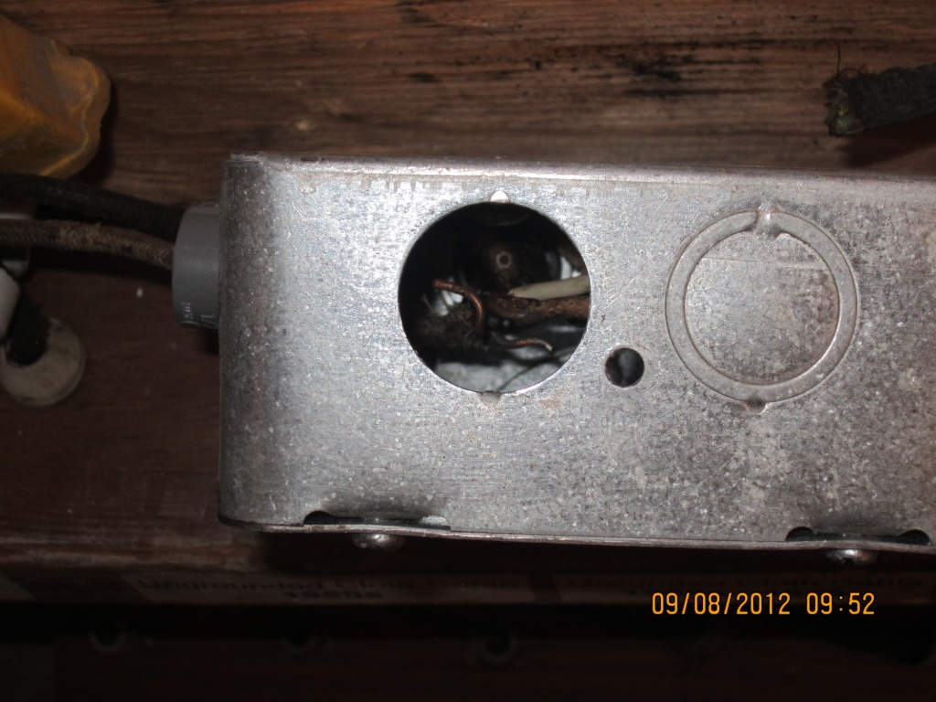
IN OLDER HOUSES Fire Hazards are everywhere!
Unfilled knock outs commonly called “Mouse holes” provide easy access to the warmth in an electrical box

Slide 20
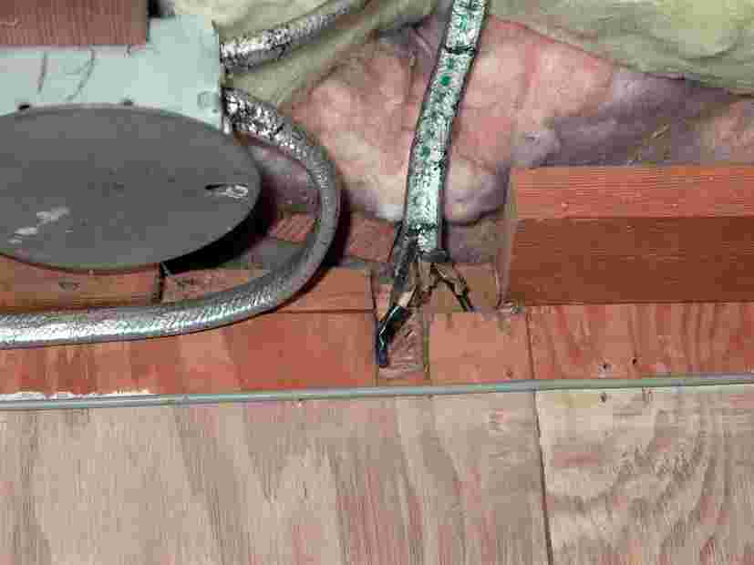
Connections not in boxes
Live electrical connections sandwiched between wooden boards

Slide 21
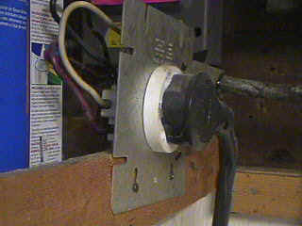
In old houses Handyman Add-on circuits are abundant
Installer failed to install an electrical box behind this dryer outlet, putting house at increased risk of fire

Slide 22
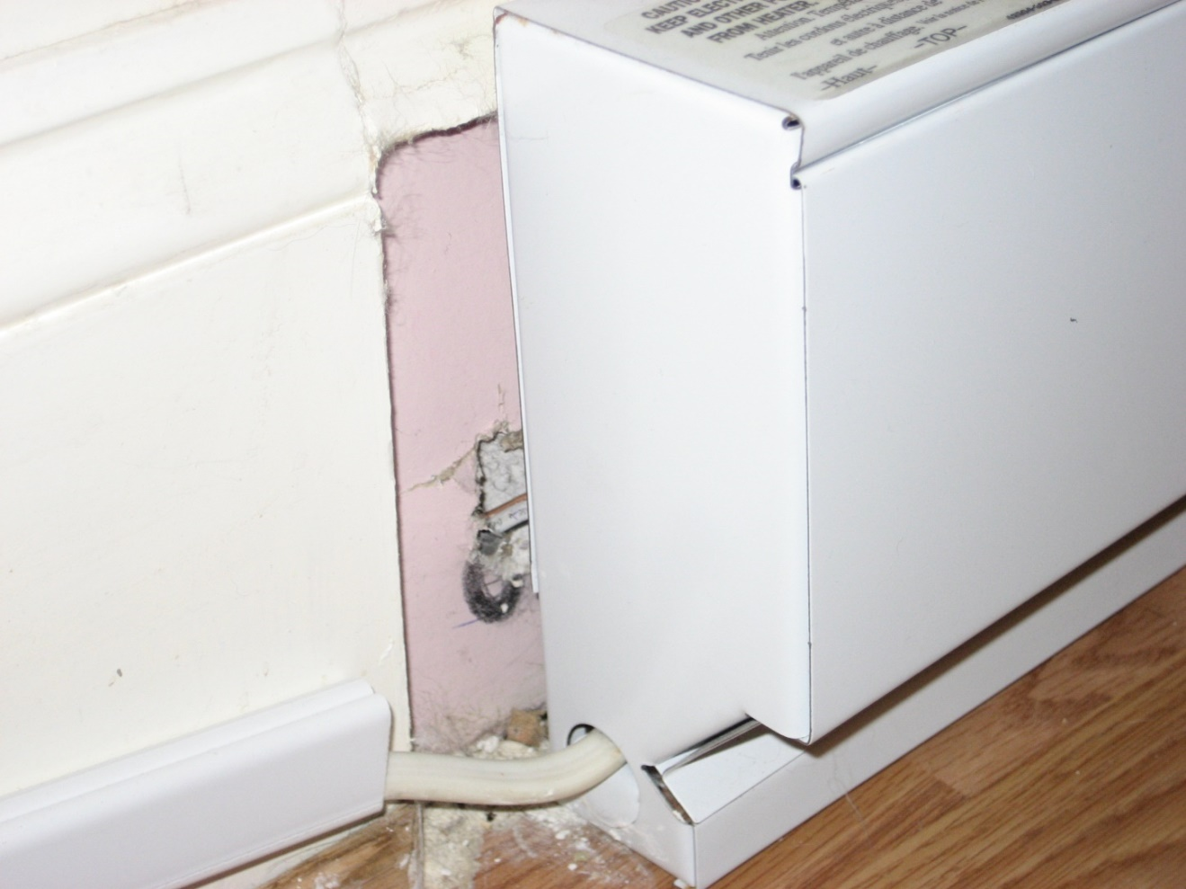
baseboard heater
Often found hazardously installed
Installer failed to install a “box connector” to
protect cable, putting house at increased risk of fire

Slide 23
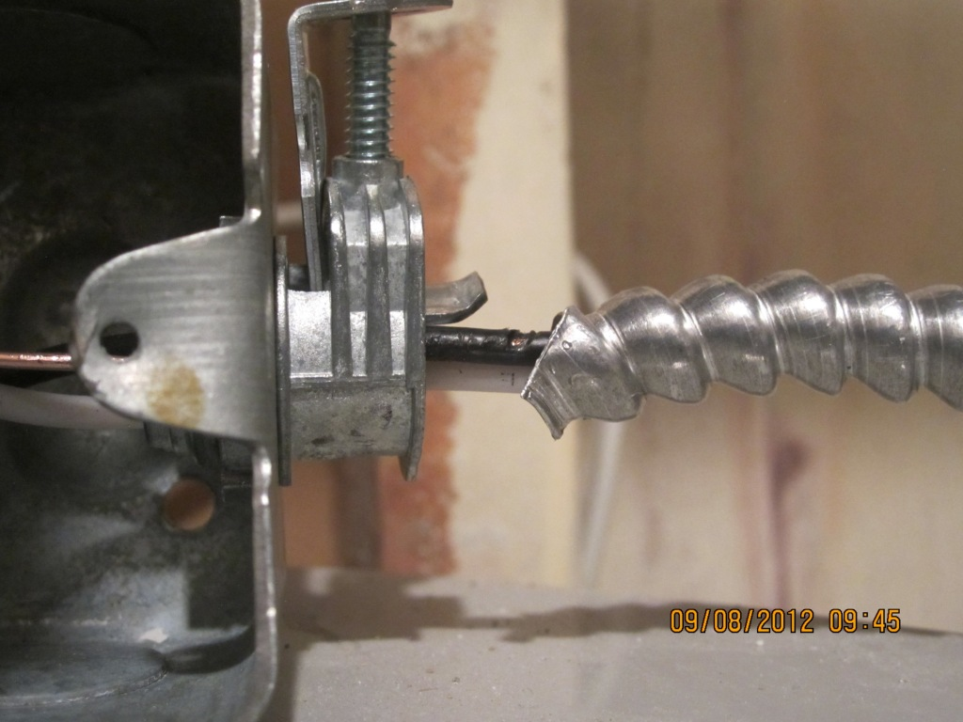
Cables without protection
Installer failed to install “Anti-short” on this cable to a new furnace, putting house at risk of fire”

Slide 24
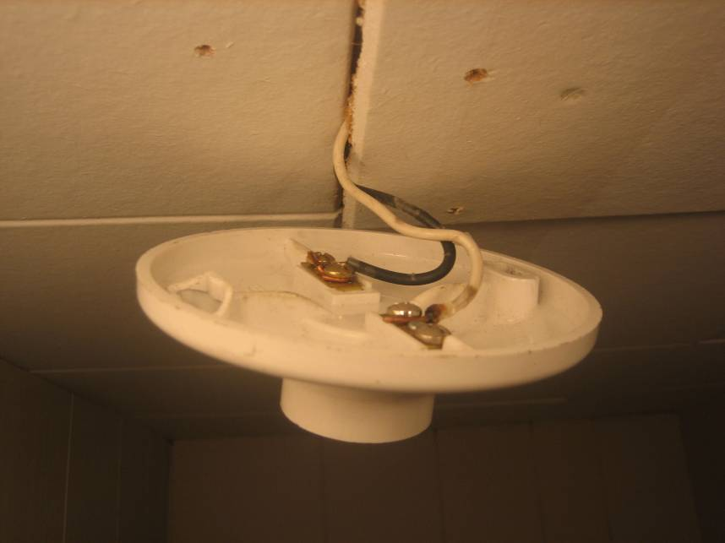
Add-on Light Fixtures
Installer failed to install a junction box behind this add-on lampholder, putting house at increased risk of fire.

Slide 25
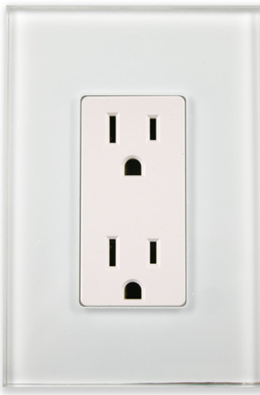
Knob and tube has concerns

Slide 26
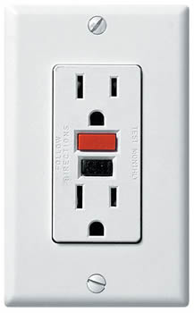
Knob and tube has solutions

Slide 27
Aluminum Wire Has Concerns

Slide 28
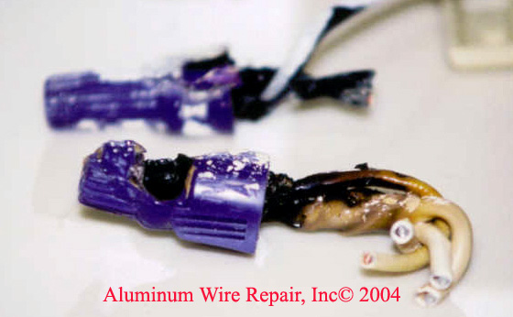
Aluminum has Solutions:
However, Copper Pigtailing MAY increase RISK
Copper Pigtailing on aluminum conductors CANNOT be done with standard wire connectors

Slide 29
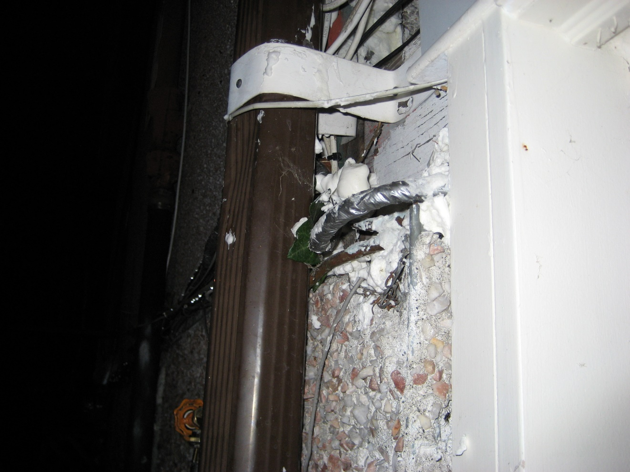
Cables for inDoors are not for outdoors
Old indoor cables have deteriorated, taped with duct tape by occupant. House is now at increased risk of fire.

Slide 30
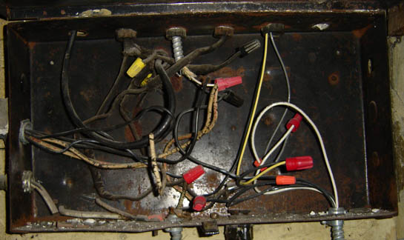
HANdyman add-on circuits:
Often found with NO regard for safety

Slide 31

With a thorough electrical Check-up, on a regular basis, Old Houses can remain safe forever
Thank you

